Slide 1
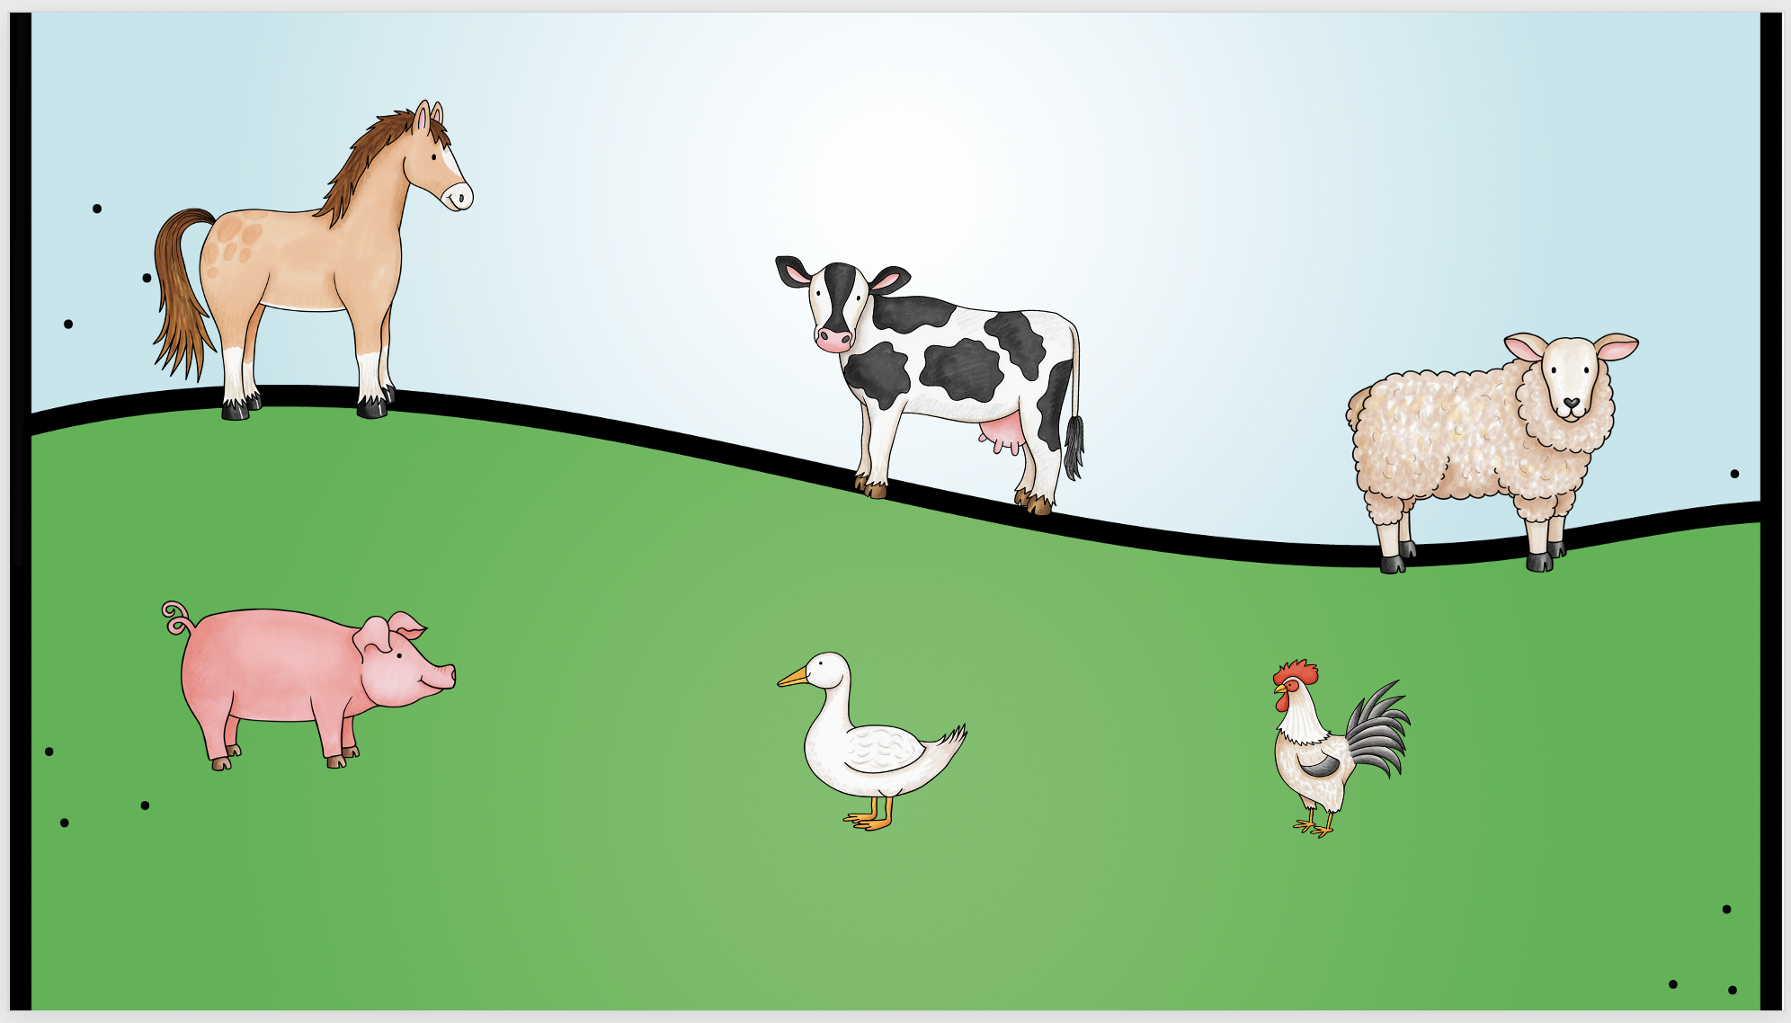
Farm Animals
Change the size of the font so it fills the rectangular label.
horse
cow
sheep
pig
duck
rooster

