Slide 1
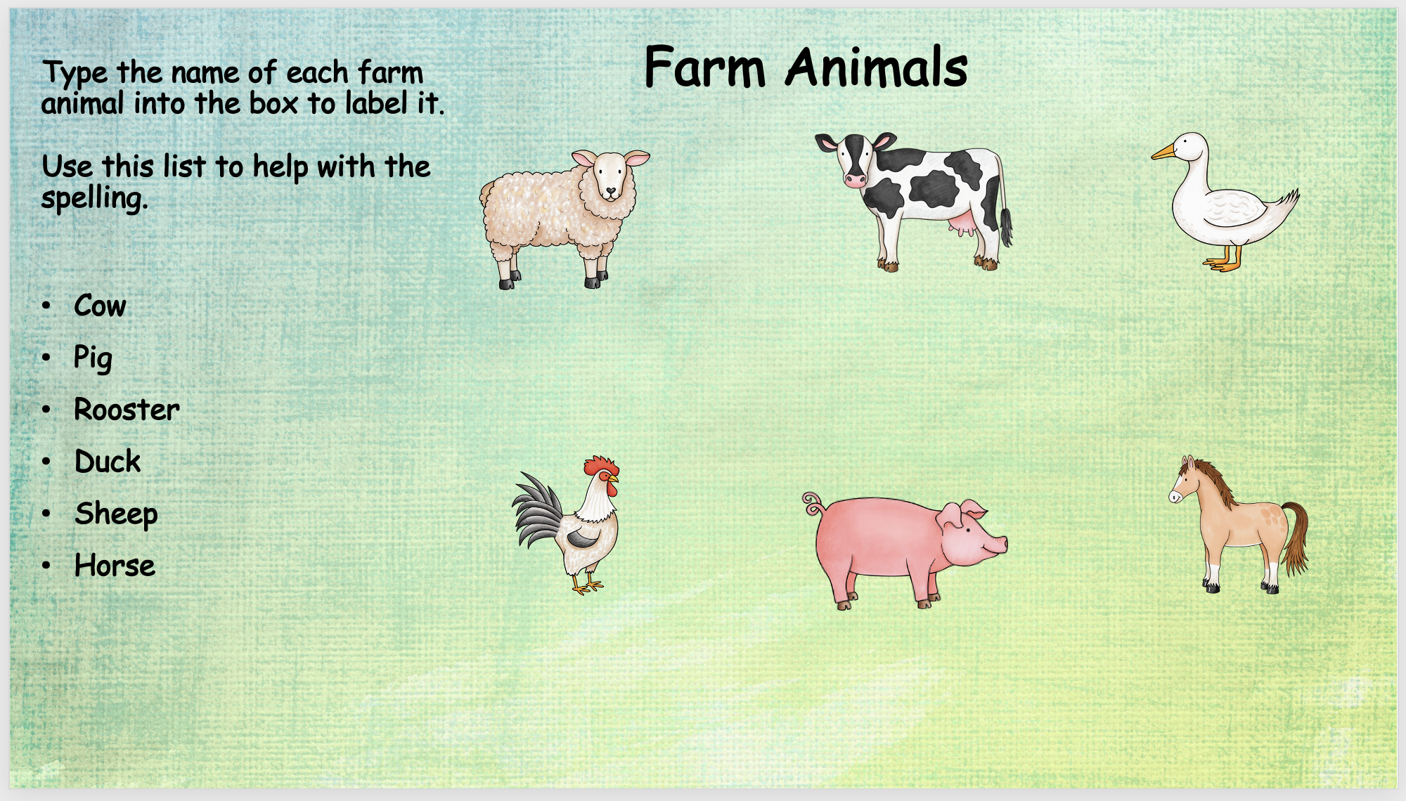
type
type
type
type
type
type

