Slide 1


Slide 2
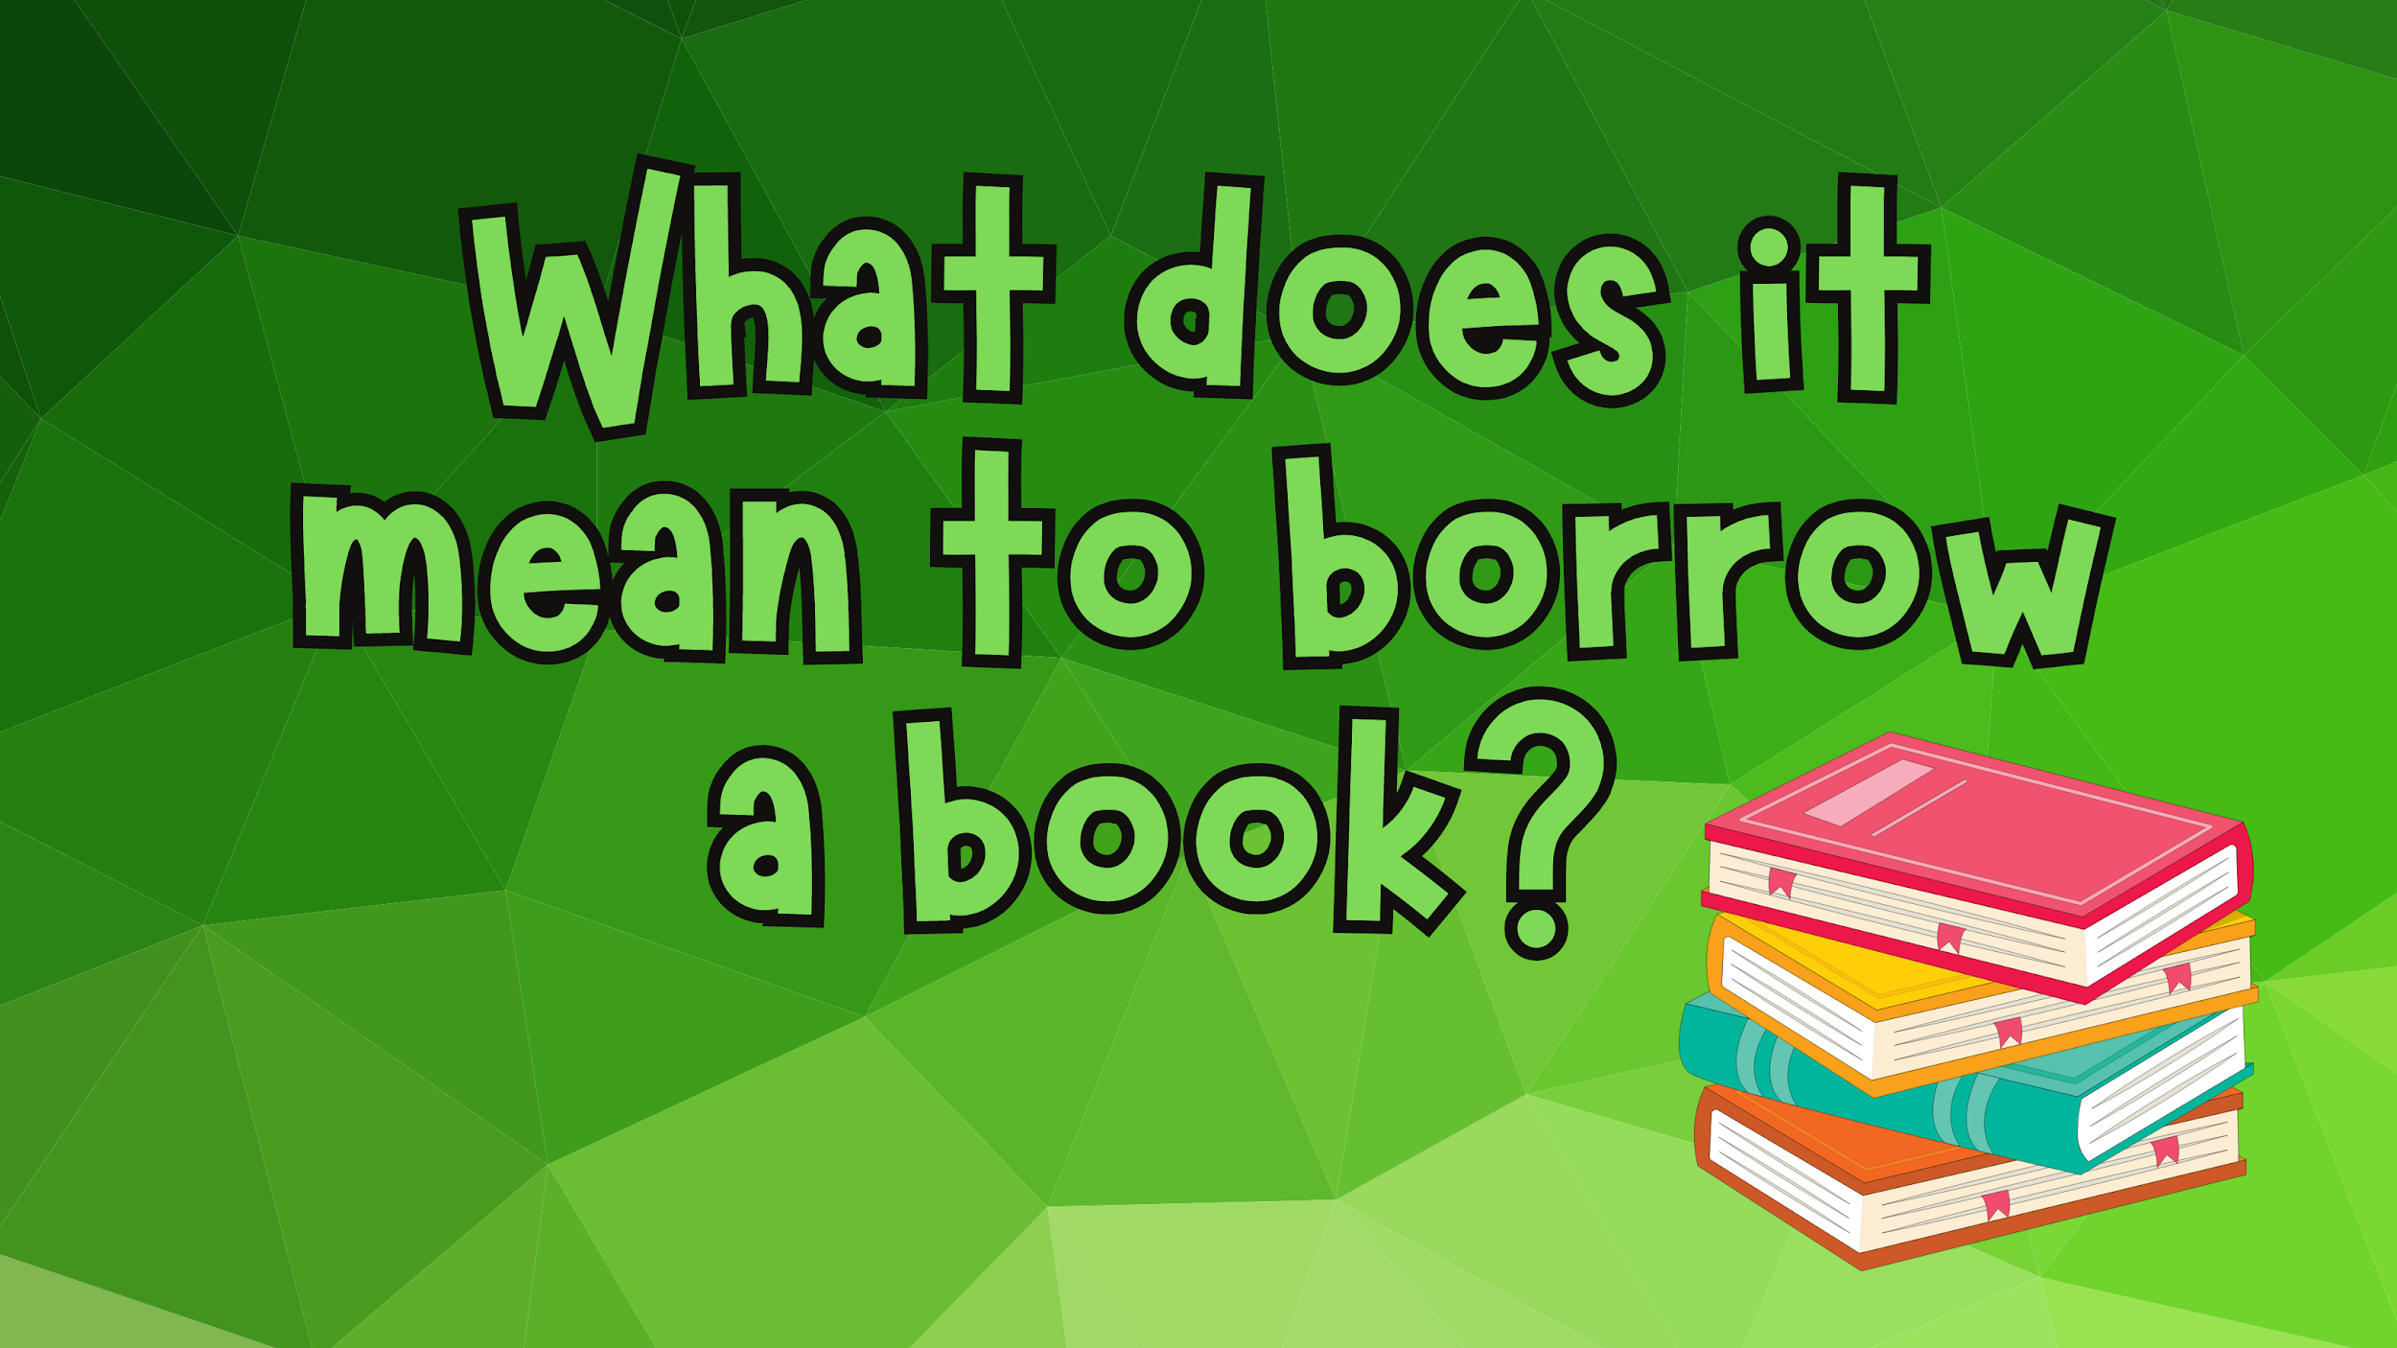
Do we get to keep library books forever? What happens if we lose our book?

Slide 3
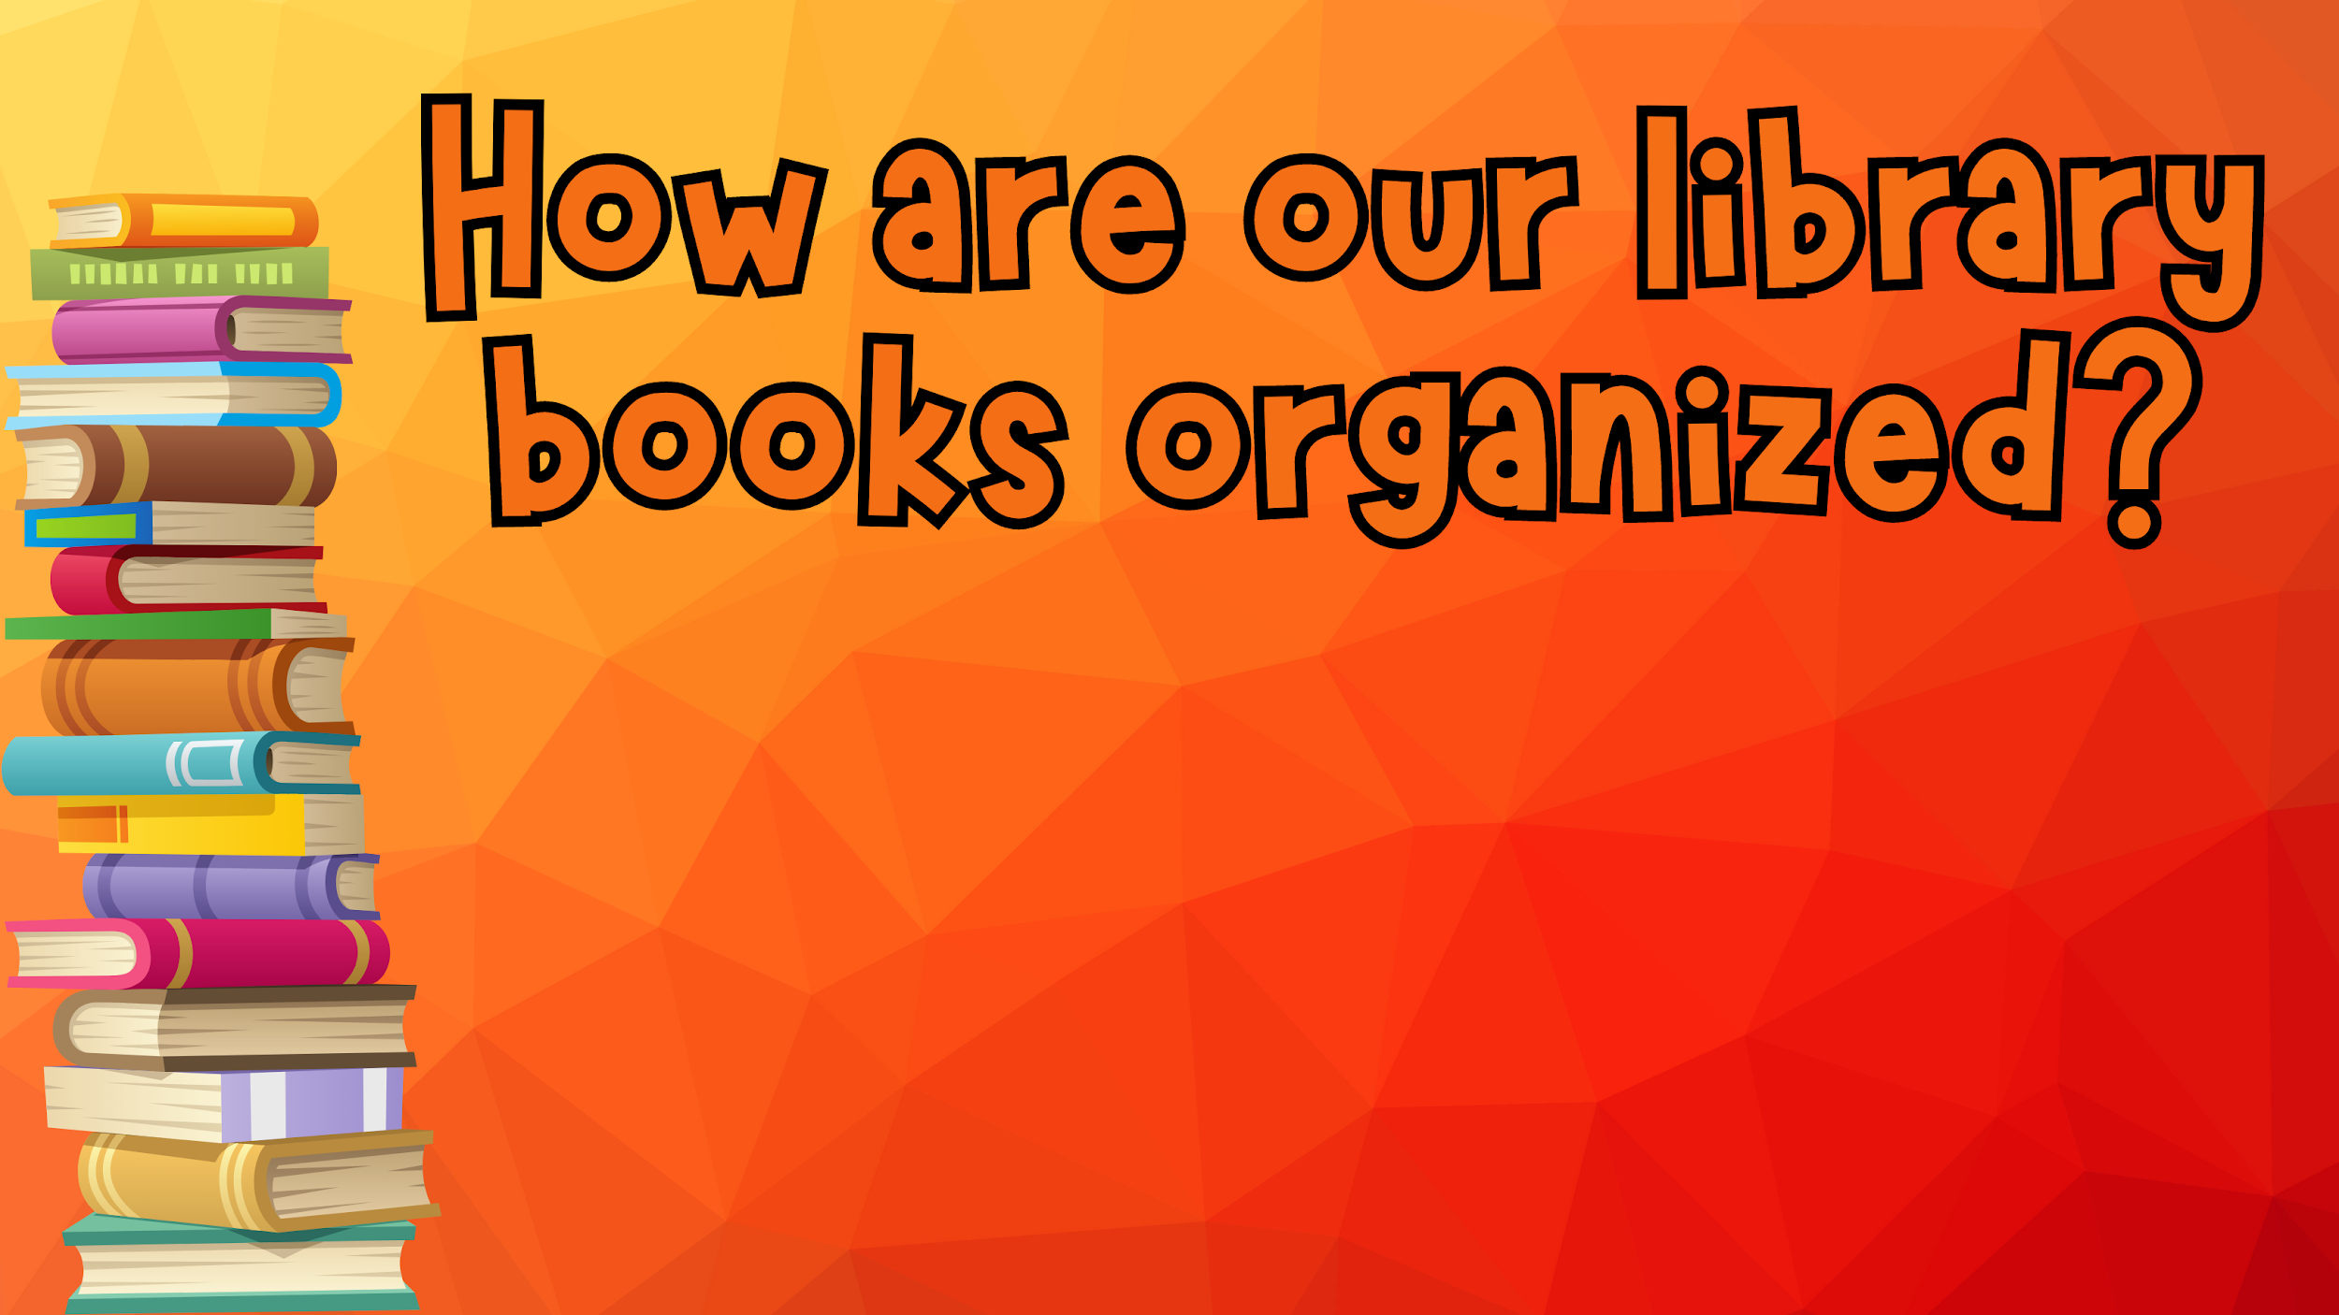
In our library we have 4 sections:
Junior Fiction - Picture Books
Book Bites - Short Chapter Books
Graphic Novels – Books in ‘comic’ form
Senior Fiction - Chapter Books
Nonfiction – A mixture of easy and higher level reading

Slide 4

If we don’t want a book we picked up where do we put it?
How can we make sure it ends up in the correct spot?
How do we put it back?

Slide 5
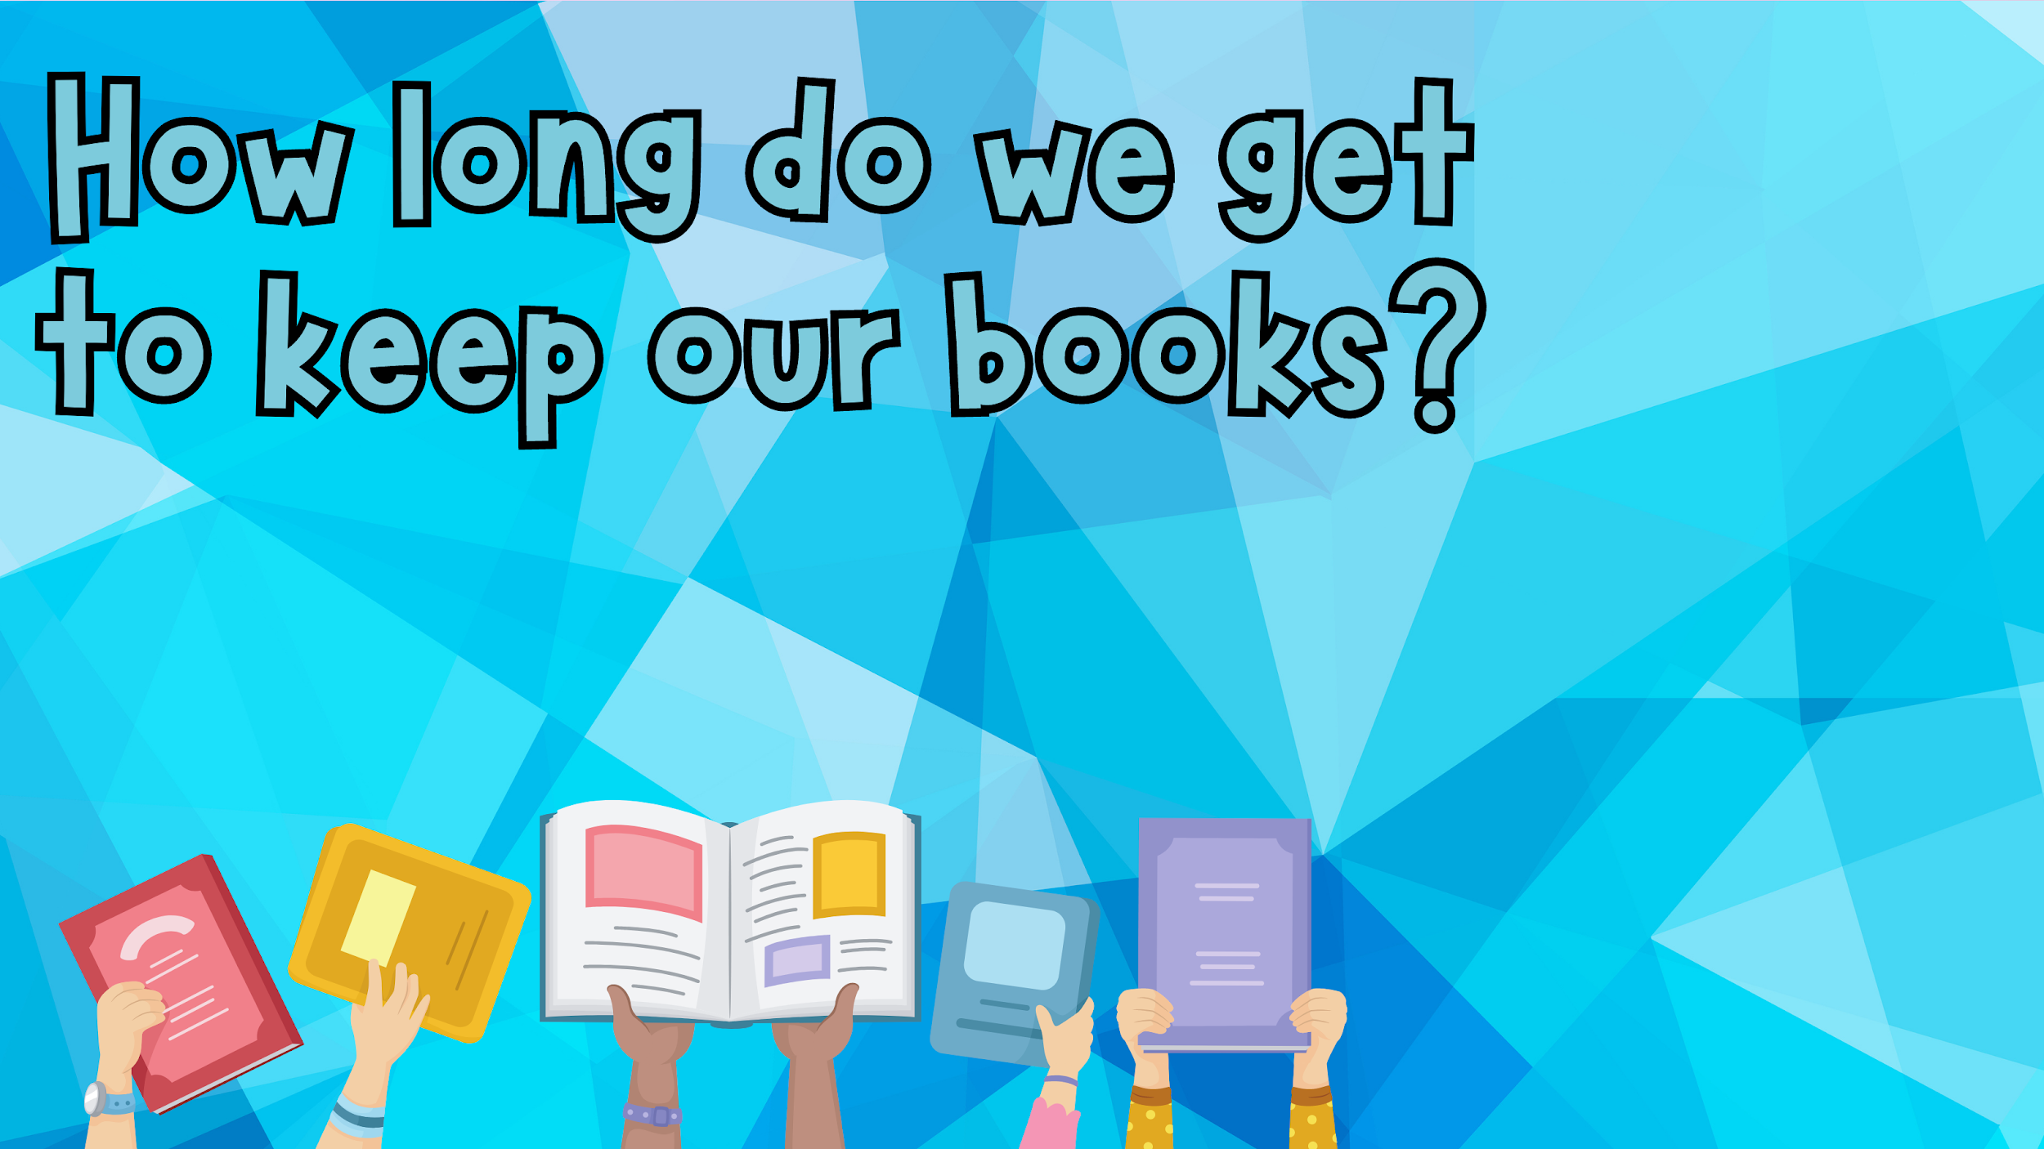
We have class once a week. Your books are due back each week. Not finished yet? Renew it for 1 more week!

Slide 6

It’s time to checkout! A library book is not yours to borrow until you check it out at our checkout desk!
Where is our checkout desk?

Slide 7


Slide 8
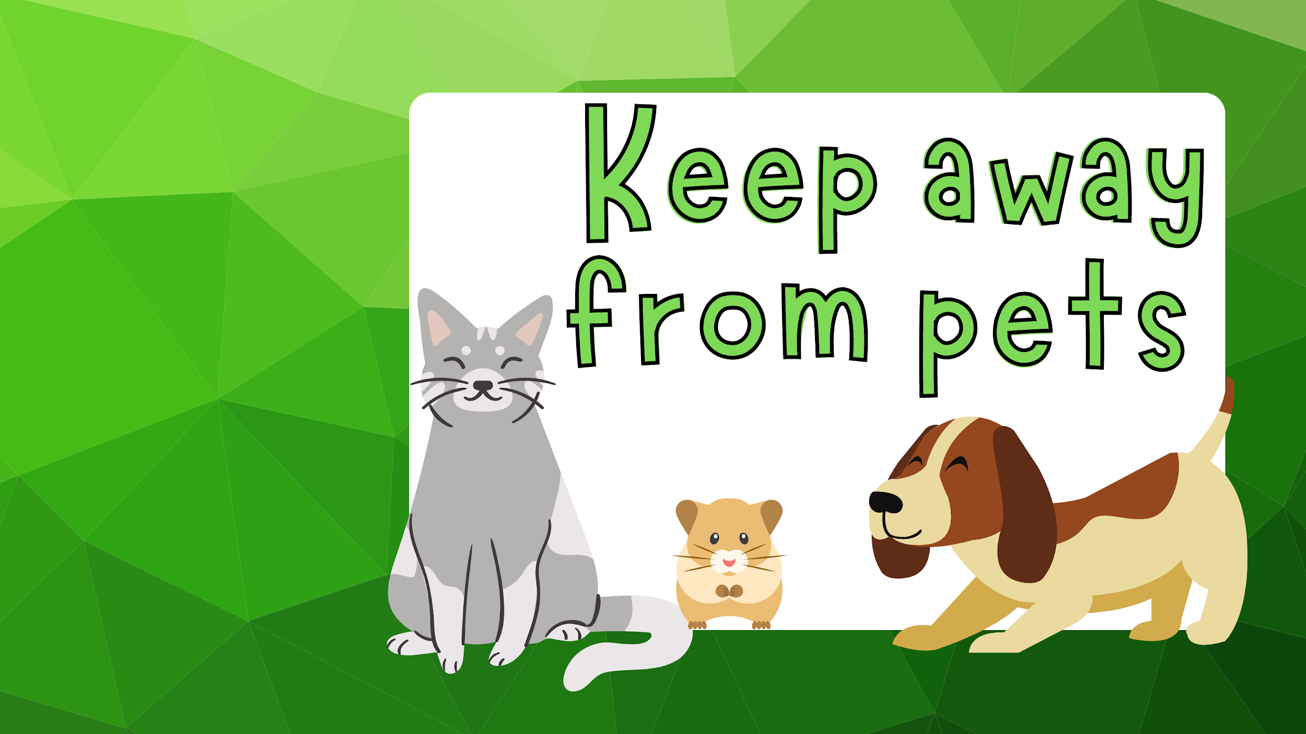
What could happen if an animal gets ahold of our library book?

Slide 9
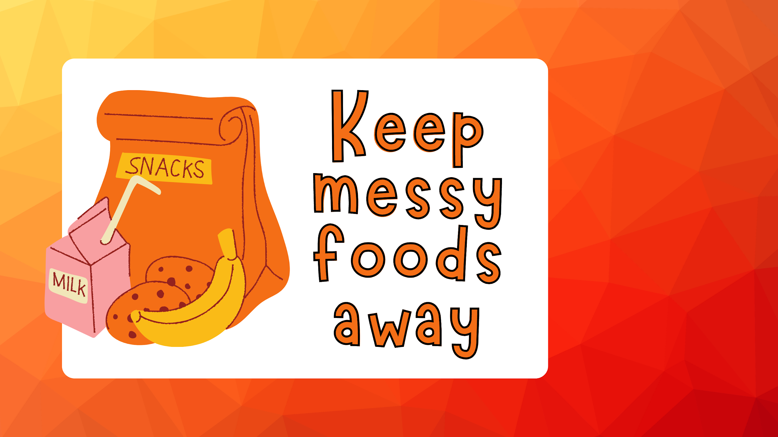
What can messy foods do to our books?
Think about allergies! We all share these books!

Slide 10
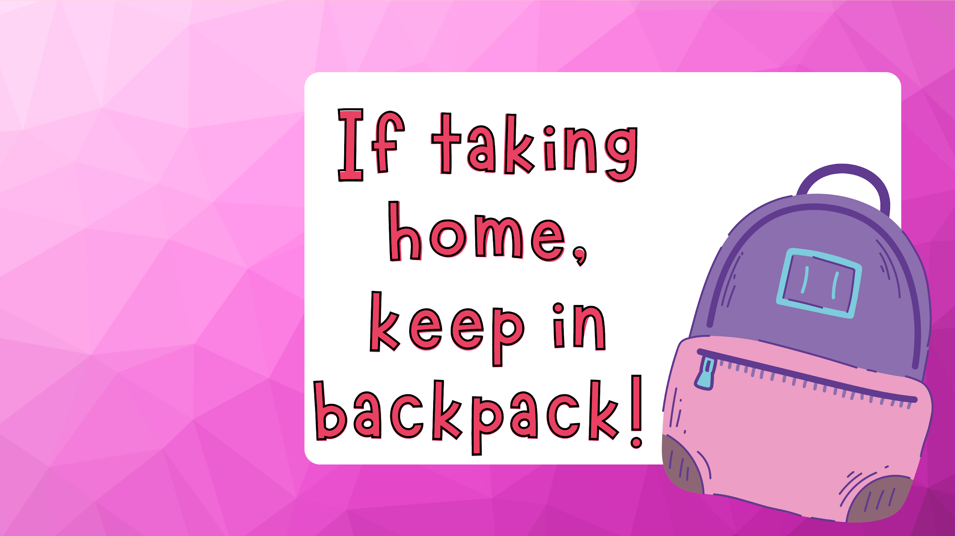
Why is your book safest in your backpack?
Can you check out new books if you forget them at home?

Slide 11

What could happen to our book spine if we use something else?
Should we fold pages?

Slide 12
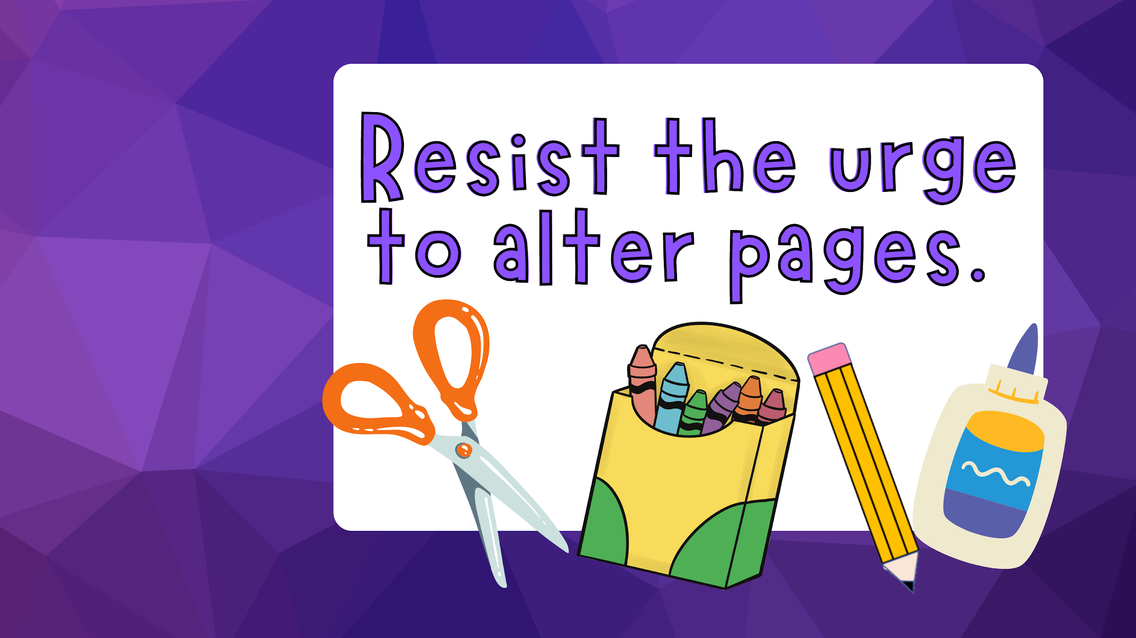
Library books are expensive!
Why should we keep our library books in good condition?

Slide 13
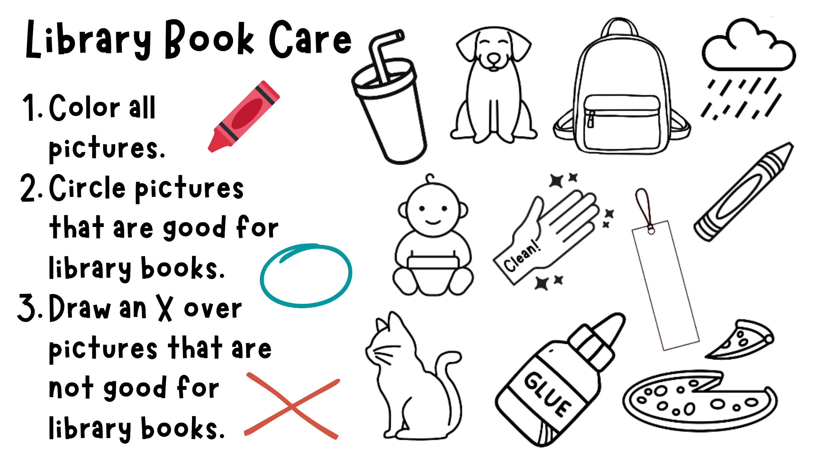
This worksheet

Slide 14

Type Title Here…
Type Body Here…

Slide 15

Type Title Here…
Type Body Here…

Slide 16

Type Title Here…
Type Body Here…

Slide 17

Type Title Here…
Type Body Here…

Slide 18

Type Title Here…
Type Body Here…

Slide 19

Type Title Here…
Type Body Here…

