Slide 1
Introduction to
Excel Spreadsheets
I can…
Label the main parts of a spreadsheet
Use simple formulae
Design and create my own speadsheet

Slide 2
What are we learning about?
A = 1 | B = 2 | C = 3 | D = 4 | E = 5 | F = 6
G = 7 | H = 8 | I = 9 | J = 10 | K = 11 | L = 12
M = 13 | N = 14 | O = 15 | P = 16 | Q = 17 | R = 18
S = 19 | T = 20 | U = 21 | V = 22 | W = 23 | X = 24
Y = 25 | Z = 26
Key
Using the key, work out the hidden message (code)
23 5 1 18 5 12 3 1 18 14 9 14 7 1 2 15 21 20
19 16 18 5 1 4 19 8 5 5 20 19 1 14 4
6 15 18 13 21 12 1 5

Slide 3
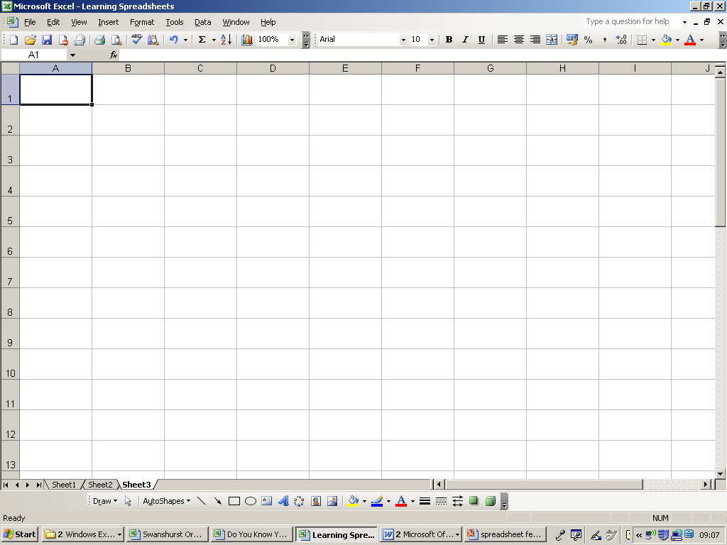
Each worksheet is made up of squared paper
Each square is called a Cell
If we click on a cell, it becomes the
Active Cell
Excel is just like your Maths Book!!!
It has lots of pages inside; called Worksheets

Slide 4
Each worksheet has Columns (Letters) and
Rows (Numbers)
Each cell has its own special name e.g. A10
This is called its Cell Address

Slide 5
Label
Excel
Label the spreadsheet with the keywords shown
Cell | Active Cell | Worksheet | Column | Row
Give an example of a cell reference:

Slide 6
Which box does the star appear in?

Slide 7
Which box does the star appear in?
J5
B6
F7
D8
F11
C12
H12

Slide 8
In Excel, calculations are
written backwards
= 2 + 2
You write down = first

Slide 9
What is the correct formula to use?
= A3+C3

Slide 10
What is the correct formula to use?
= A3+C3
= A4/C4

Slide 11
What is the correct formula to use?
= A3+C3
= A4/C4
= A5*C5

Slide 12
What is the correct formula to use?
= A3+C3
= A4/C4
= A5*C5
= A6-C6

Slide 13
What is the correct formula to use?
= A3+C3
= A4/C4
= A5*C5
= A6-C6
= A7+C7

Slide 14
Excel Calculations
Answer the questions below
Question | Answer
What symbol must a formula always start with?
What symbol would you use to add two numbers together?
What symbol would you use to subtract a number?
What symbol would you use to multiply two numbers?
What symbol would you use to divide a number?

Slide 15
Excel Calculations
Using the spreadsheet write the correct formula in the table. The first one has been done for you.
Cell reference | Formula
A1 add B1 | =A1+B1
E5 add B5
D3 subtract A1
D4 multiply by E4
C6 multiply by 2
C1 divide by E1

Slide 16
Draw around your hand and write down 5 things you have learnt about Google Sheets on each finger and thumb.
Excel

