Slide 3
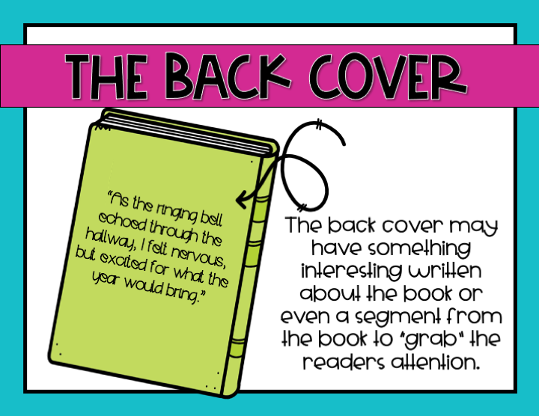

Slide 8
Title
page
spine
Table of
contents
Front
cover
Back
Cover

Slide 13
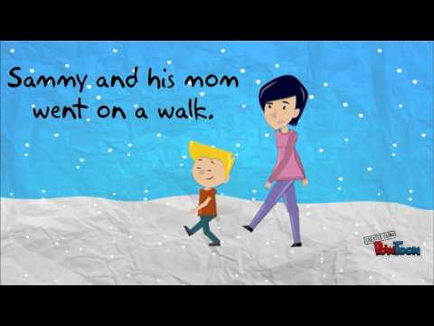

Slide 14
I enjoy the books!
I write the words!
I draw the pictures!

