Slide 1
Parts of a Book: Direct Instruction and Quick Quiz

Slide 2
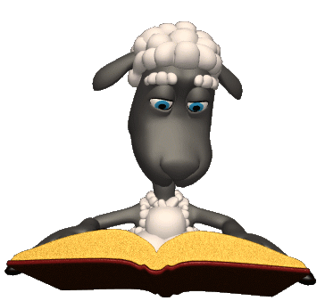
There are many different parts to a book:
Front Cover
Spine
Title Page
Copyright Page
Table of Contents
Glossary
Index
Bibliography
It is important to know what they all are, and where they can be found to get the information you need!

Slide 3
FRONT COVER
Contains the Title, Author, and Illustrator’s Name

Slide 4
SPINE
Most spines have the title and author’s name. In the library, the book’s spine contains the call number.
Call of the Wild
By Jack London
SF
LON

Slide 5
TITLE PAGE
Also contains the Title, Author, and Illustrator’s Name
Goodnight Moon
Written by
Margret Wise Brown
Illustrations by
Clement Hurd

Slide 6
COPYRIGHT PAGE
Behind the Title page
Gives you the Copyright Date, which is when the book was published, and what company published it.
Textbooks have the Edition Number on the page.
4th Grade Science
Copyright 2009
By
ABC Publishers Inc.
3rd Edition

Slide 7
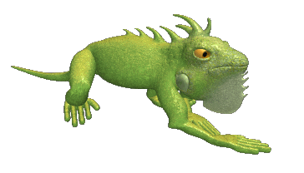
TABLE of CONTENTS
Comes after the Title and Copyright pages
Contains Chapter Headings (titles of each chapter)
Chapter 1 What is an Iguana? Pg. 1
Chapter 2 Where do Iguanas Live? Pg. 5
Chapter 3 What do Iguanas Eat? Pg. 8

Slide 8
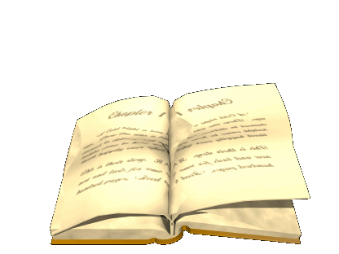
BODY of the BOOK
Main part of the book (the story or text)

Slide 9
GLOSSARY
Located in the back of the book.
A mini-dictionary in alphabetical order with new, difficult, and key words.
Tulip (too-lip)
A flower with colorful petals that blooms in springtime.
Umbrella (um-brel-ah)
A device used to keep yourself dry when it rains.
Vulture (vul-tr)
A bird that feeds off of dead animals.
Walrus (wall-ris)
A large mammal with tusks that lives in the ocean.
Year (yeer)
A length of time measured by 365 days.
Zoology (zoo-o-logy)
The study of animals and their habitats.

Slide 10
INDEX
Located in the back of the book.
List of topics and subjects in alphabetical order.
Gives the page number of where you can find that topic or subject.
A
Aardvark pg. 3
Anteater pg. 10
Antelope pg. 5
B
Baboon pg. 14
Bear pg. 7
Bird pg. 20
C
Cat pg. 8
Cheetah pg. 11
Clam pg. 15
D
Dog pg. 6
Dolphin pg. 17
Duck pg. 21
E
Eagle pg. 12
Eel pg. 16
Elephant pg. 9
F
Fish pg. 18
Fox pg. 23
Frog pg. 15

Slide 11
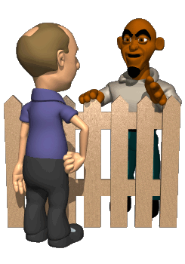
BIBLIOGRAPHY
Normally found at the end of a book.
Each ‘citation’ tells about other books that were used to create it.
Each ‘citation’ contains the author, publisher, and date of publication.
Green, Henry. Helping Hands, Published by RW Publishers, 2001.
Redding, Paul. Being a Good Neighbor, Published by Book Friends Publications, 1997.

Slide 12
Now, let’s see if you can identify which part of the book you need, to find the information I ask for! Some questions can have more than one answer! Get your whiteboards or pencil and paper ready!

Slide 13
Where do you go to find this information?
What page each chapter
starts on?
lYour choices are:
Front Cover
Spine
Title Page
Copyright Page
Table of Contents
Body of the Book
Glossary
Index
Bibliography
caTable of Contents

Slide 14
Where do you go to find this information?
To look up what a word means
from your story?
lYour choices are:
Front Cover
Spine
Title Page
Copyright Page
Table of Contents
Body of the Book
Glossary
Index
Bibliography
caGlossary

Slide 15
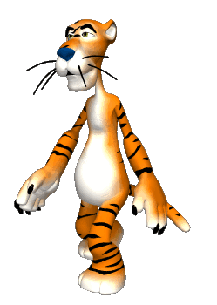
Where do you go to find this information?
To find out which page in your
book talks about tigers.
lYour choices are:
Front Cover
Spine
Title Page
Copyright Page
Table of Contents
Body of the Book
Glossary
Index
Bibliography
Index

Slide 16
Where do you go to find this information?
To find out who the author of
the book is?
lYour choices are:
Front Cover
Spine
Title Page
Copyright Page
Table of Contents
Body of the Book
Glossary
Index
Bibliography
Front Cover or Title Page

Slide 17
Where do you go to find this information?
To find out when the book was
published/made?
lYour choices are:
Front Cover
Spine
Title Page
Copyright Page
Table of Contents
Body of the Book
Glossary
Index
Bibliography
Copyright Page

Slide 18
Where do you go to find this information?
To find the other books used
to help create the book
you’re reading?
lYour choices are:
Front Cover
Spine
Title Page
Copyright Page
Table of Contents
Body of the Book
Glossary
Index
Bibliography
Bibliography

Slide 19
Where do you go to find this information?
To find the call number of a
book in the library?
lYour choices are:
Front Cover
Spine
Title Page
Copyright Page
Table of Contents
Body of the Book
Glossary
Index
Bibliography
Spine

Slide 20
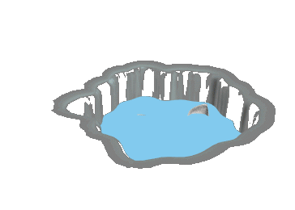
Where do you go to find this information?
To find out what page
information about polar bears
is on?
lYour choices are:
Front Cover
Spine
Title Page
Copyright Page
Table of Contents
Body of the Book
Glossary
Index
Bibliography
Index

Slide 21
Where do you go to find this information?
To find out what page chapter
five starts on?
lYour choices are:
Front Cover
Spine
Title Page
Copyright Page
Table of Contents
Body of the Book
Glossary
Index
Bibliography
Table of Contents

Slide 22
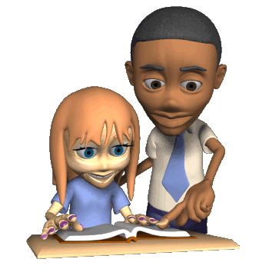
Where do you go to find this information?
To find out what year the book
was published?
lYour choices are:
Front Cover
Spine
Title Page
Copyright Page
Table of Contents
Body of the Book
Glossary
Index
Bibliography
Copyright Page

Slide 23
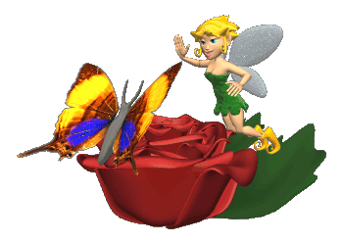
Where do you go to find this information?
To look up the word
fantasy from your reading
text book.
lYour choices are:
Front Cover
Spine
Title Page
Copyright Page
Table of Contents
Body of the Book
Glossary
Index
Bibliography
Glossary

Slide 24
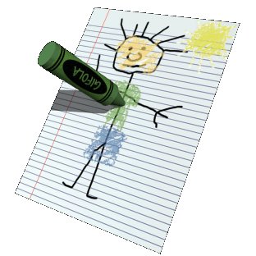
Where do you go to find this information?
To find out who the illustrator
of the book is?
lYour choices are:
Front Cover
Spine
Title Page
Copyright Page
Table of Contents
Body of the Book
Glossary
Index
Bibliography
Front Cover or Title Page

Slide 25
The End

