Slide 1
Oliver/ Orbit Library Catalogue
Scavenger Hunt

Slide 2
Types of Search
The 3 type of searches in Oliver are?
Notes:
Type the answers straight into the boxes.

Slide 3
Types of Search
What type are the following?
AUTHOR
Roald Dahl
Birds
Endangered Animals of Australia
Computers
The History of Theatre
SUBJECT
TITLE
AUTHOR
SUBJECT
TITLE
Notes:
Type the answers straight into the boxes.

Slide 4
Dewey Decimal
Using Oliver, find the Dewey Numbers for the following subjects:
Aboriginal Myths
Cats
France
Mathematics
Energy
Netball
Notes:
Type the answers straight into the boxes.

Slide 5
Call Numbers
Find the call numbers for the following books:
The Twits
Harry Potter
Geronimo Stilton
PIG the Pug
Diary of a Wimpy Kid
Bad Guys
Notes:
Type the answers straight into the boxes.

Slide 6
Orbit
In Orbit, find the following information:
How many books have you borrowed?
Do you have any overdue books?
What was the last book that you borrowed?
Notes:
Type the answers straight into the boxes.

Slide 7
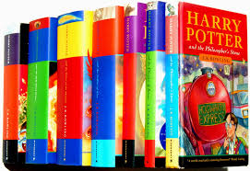
Oliver Search
Search - title:
Search for Harry Potter books.
What section of the library are they kept?
Notes:
Type the answers straight into the boxes.

Slide 8
Oliver Search
Search - Author:
Search for Mem Fox.
How many of her books do we have in the library?
Notes:
Type the answers straight into the boxes.

Slide 9
Oliver Search
Search - WOrd:
Search for Where’s Wally.
What is the Dewey decimal number for Where’s Wally in Hollywood?
Notes:
Type the answers straight into the boxes.

Slide 10
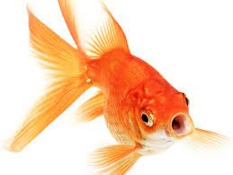
Oliver Search
Search - series:
Search for fish.
What series is the first on the list to choose from?
Notes:
Type the answers straight into the boxes.

Slide 11
Oliver Search
Search - Author:
Search for Alison Lester.
Write down 3 of her books that we have in the library.
Notes:
Type the answers straight into the boxes.

Slide 12
Oliver Search
Search - word:
Search for bear.
If I wanted a Non-Fiction book about bears what book would be good to read?
Write down the title:
Dewey Decimal number:
Notes:
Type the answers straight into the boxes.

Slide 13
These slides are locked so that the students can’t move the background pieces and can only type in the answers.
Delete this text box.

Slide 14
Notes:
Type the answers straight into the boxes.

Slide 15
AUTHOR
SUBJECT
TITLE
AUTHOR
SUBJECT
TITLE
Notes:
Type the answers straight into the boxes.

Slide 16
Notes:
Type the answers straight into the boxes.

Slide 17
Notes:
Type the answers straight into the boxes.

Slide 18
Notes:
Type the answers straight into the boxes.

Slide 19
Notes:
Type the answers straight into the boxes.

Slide 20
Notes:
Type the answers straight into the boxes.

Slide 21
Notes:
Type the answers straight into the boxes.

Slide 22
Notes:
Type the answers straight into the boxes.

Slide 23
Notes:
Type the answers straight into the boxes.

Slide 24
Notes:
Type the answers straight into the boxes.

